Slide 1


Economic Systems and Quality of Life

Slide 2
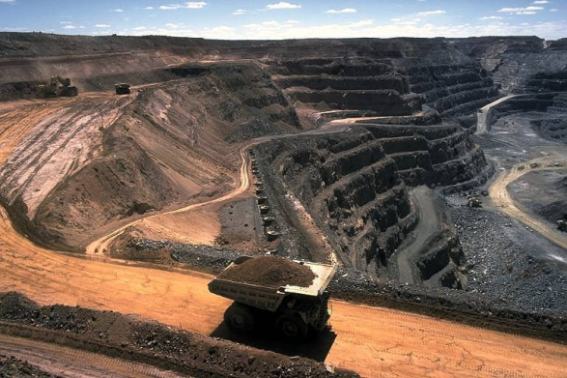

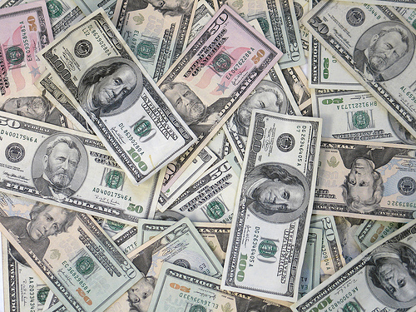
Scarcity
Want vs. need
Why might something be scarce?
Land – ALL materials
Labour – physical and mental effort
Capital – money (and anything worth money)

Slide 3

What is Scarce?
And does it have to be?

Slide 4
Public Ownership
If the government owns something, what are they trying to do with it?
Private Ownership
If a business owns something, what are they trying to do with it?

Slide 5

For each of the following, answer whether you think it should be publicly or privately owned.
Gold
Oil & Gas
Agriculture
Water
Forest Parks
Schools
Health Care

Slide 6


Economic Systems – How do you solve scarcity?
Planned
Market
Government makes all of the decisions
Gov’t owns and manages resources
Publicly owned
Individual consumers have little influence on economic decision making
Private business makes decisions
Individuals make decisions on how to use resources
Privately owned
Individual consumers drive economic decision making by choosing what to buy

Slide 7


What about Canada?
A “mixed” economy
Some resources are publicly owned and some are private
Individuals and government both make decisions about what to produce
Individual consumers and government influence economic decision making
This “mix” can change depending on the party in power

Slide 8
To prepare you for Grade 12 and LIFE
Is it better for the public good to work together or for each person to work as individuals?
Public Good: the benefit or well-being of the public.

Slide 9
SOC 9
Current Events
Economic Notes
Start Writing assignment

Slide 10
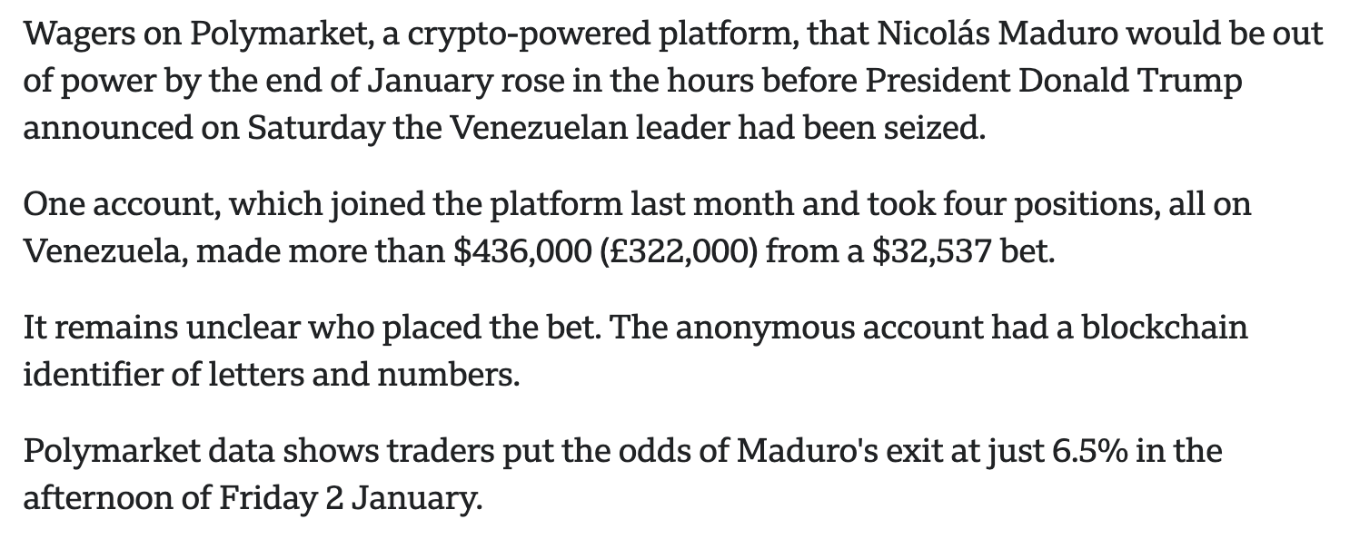

Slide 11

Market Economy vs. Planned
Self Driving Cars

Slide 12
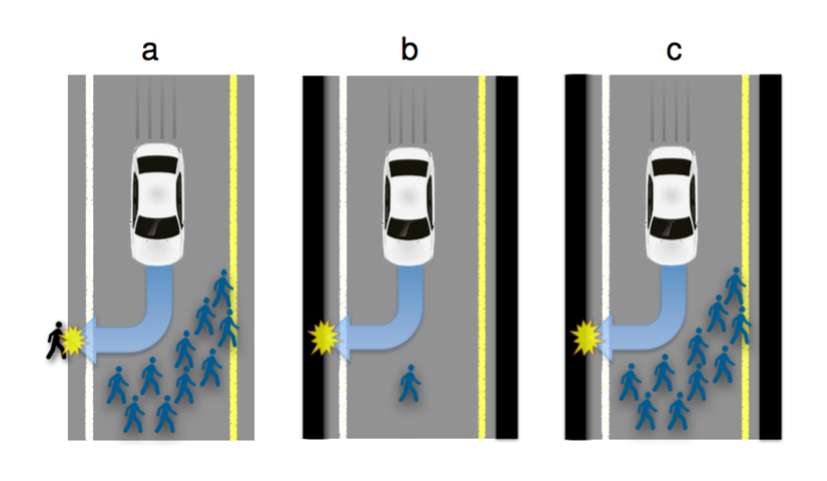

Slide 13
This time ask yourself:
Is it better for the public good to work together or for each person to work as individuals?
What would it look like to “work together”? Who pays? Who is rewarded?
What would it look like to have individuals working alone? Who pays? Who is rewarded?
What’s best for the public?
So.... Solve:
Better smartphones
Better education
Cancer
Climate Change

Slide 14
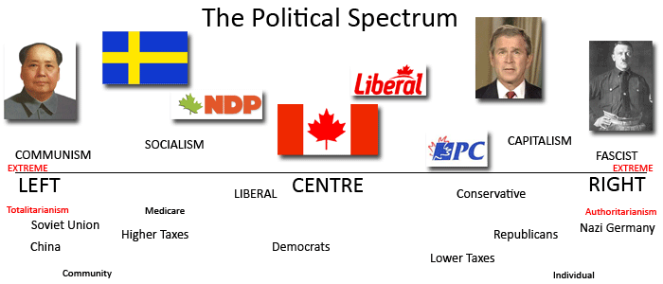


Canada’s Economy – Peace, Order & Good Government
Founding principle of Canada reflects the idea of cooperation, connected to Francophone/Anglophone beginnings
Cooperation is important for the Canadian economy but competition plays a role as well. This is why we have a mixed economy.
However, our place on the continuum moves around depending on who is in power at the moment.
Draw a continuum in your own notes!

Slide 15
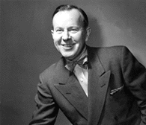
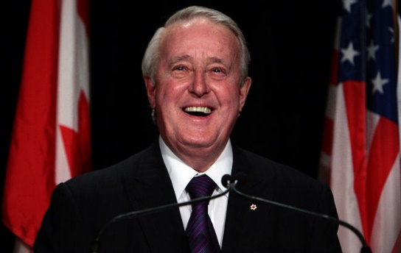
Canada’s Economy – Peace, Order & Good Government
1963 – 1968 Liberal Party
1984 – 1993 Progressive Conservative Party
Shift Left
Shift Right
Brian Mulroney forms a majority government. Reduces involvement in the economy, including:
Cuts to government spending
Privatizing government-owned corps (more on that later).
Signed NAFTA (North American Free Trade Agreement)
Lester B. Pearson formed a minority government and cooperated with the NDP
Larger role in the economy, including:
Publicly funded health care
Pensions for senior citizens

Slide 16
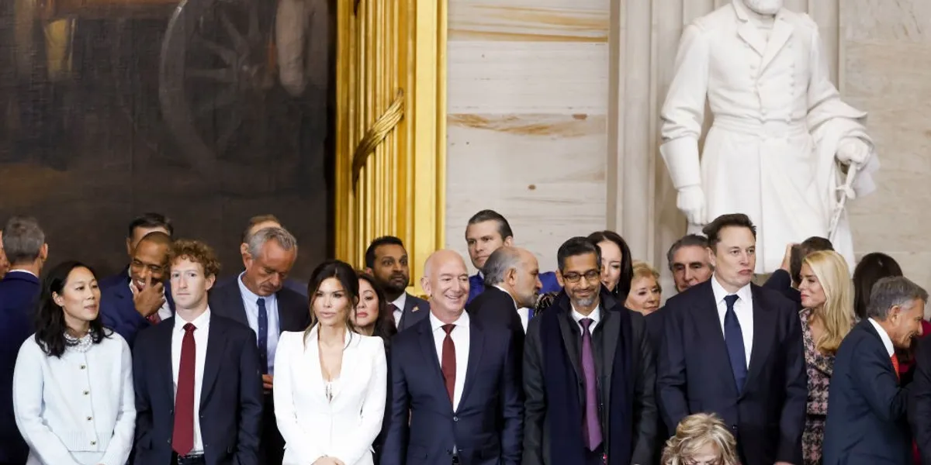
The U.S. Economy – Life, Liberty and the Pursuit of Happiness
Founding principle reflects the idea individualism.
Influences the economic system of the U.S. where individuals have more power and the government has little involvement (Market economy)
The position on the economic continuum shifts right and left depending on who is in power.

Slide 17
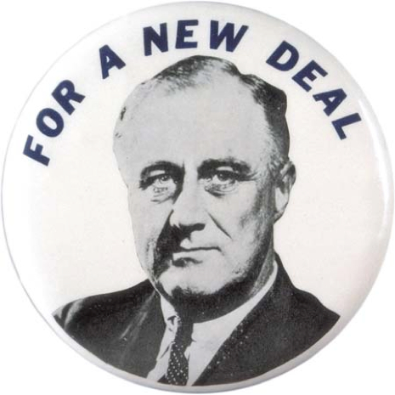

United States’ Economy – Life, Liberty and the Pursuit of Happiness
1933 – 1944 Democratic Party
1980 – 1988 Republican Party
Shift Left
Shift Right
Franklin Roosevelt had to respond to the Great Depression, did so with the “New Deal”
Larger role in the economy, including:
Funds to support farmers
Pensions for senior citizens
Corporations run by gov’t, public works projects (roads, dams)
Ronald Reagan wanted less involvement in the economy:
Reduced government spending
Reduced government regulations on corporations (for example, environmental standards).

Slide 18
Supply and Demand
Time to explain how the world works.

Slide 19
Soc 9
Limitless Phone Case: $950
Makeup: $875
Bombit: $1025

Slide 20




Slide 21

$875

Slide 22

$950

Slide 23

$1025

Slide 24
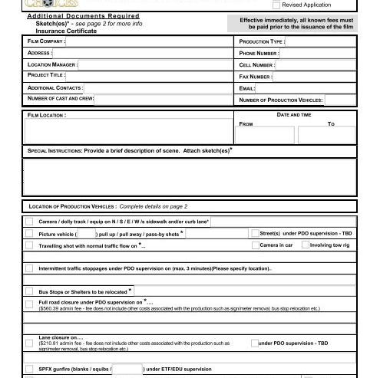
To get a “film permit”
Script
Some version of a storyboard
List of props going to be used THAT DAY
List of locations for filming THAT DAY
Expected time of return to class

Slide 25
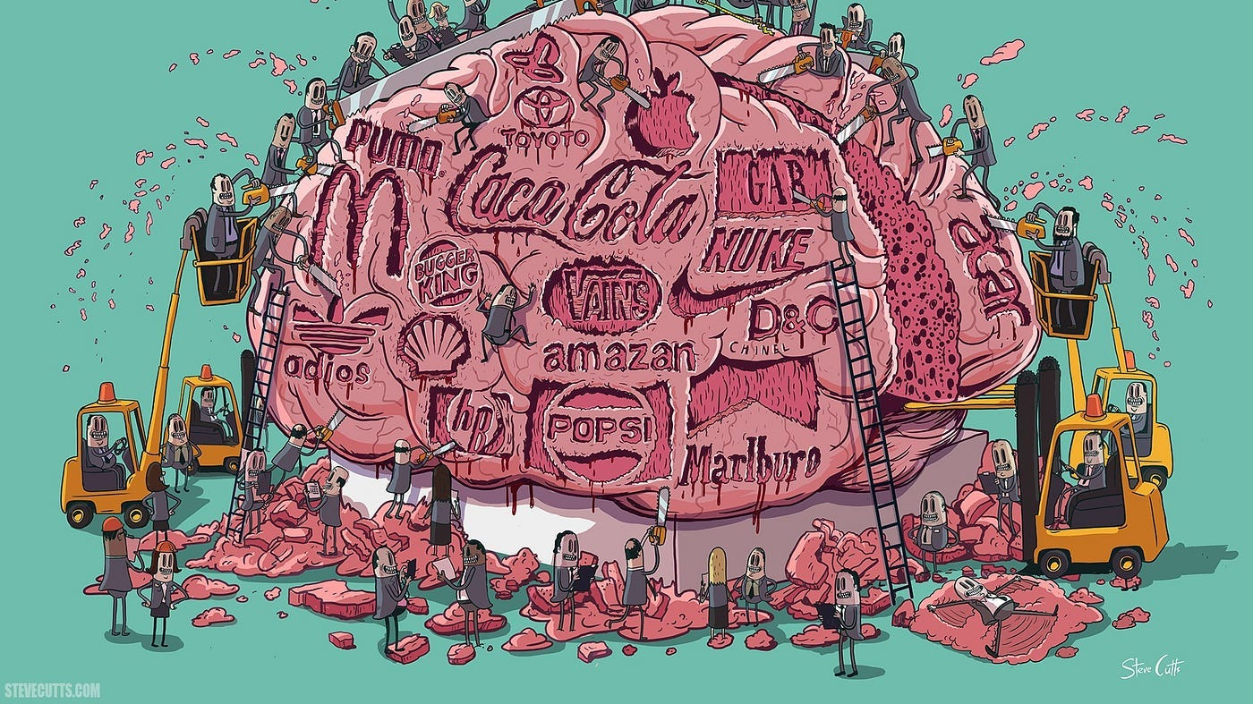
Consumerism
Is it good to buy? How much is too much?

Slide 26

ADVERTISING TECHNIQUES
Bandwagon Effect
• Encourages you to buy a product or service because everyone else is.
Emotional Appeal
• Uses strong emotional language that connects with your fears and desires.
Glittering Generalities
• Relates the product or service to words or images that promise everything, but deliver little or nothing.
Plain Folks Appeal
• Relates a product or service to the experience of ordinary folks.
Testimonials
• Uses celebrities or experts to speak for a product.
Scientific Appeal
• Uses statistics or scientific data to persuade consumers to buy a product or service.

Slide 27
Advertising ”Rubric”

